Slide 1

TAXI RADAR
Predict. Plan. Ride.

Slide 2
INDEX
Feature Importance
Result
App Demo
Challenges Faced
Our Learning
Future Enhancements
Conclusion
Team Introduction
Purpose
Important Use Case
Business Use Case
Data Collection
Concepts We Used
Model Used
Model Comparison

Slide 3





TEAM INTRODUCTION
Ishan
Group Leader
Aryaman
Naman
Risha
Keerthivasan

Slide 4
Why To Use Taxi Radar?
• Optimize taxi services and reduce wait times
• Aid urban planning and infrastructure development
• Mitigate traffic congestion
• Enhance economic benefits for taxi companies
• Reduce environmental impact through efficient resource allocation

Slide 5
ABSTRACT
• Predicts taxi demand with Random Forest Regressor and geospatial analysis.
• Analyzes locations, timestamps, and time intervals.
• Forecasts high-demand areas in 2-hour intervals.
• Optimizes taxi fleet management and urban transport.
• Enables smarter, data-driven decisions.

Slide 6
IMPORTANT USE CASE
• Urban Planning and Public Transportation Management
• Identify High-Traffic Areas
• Optimize Public Transit Routes
• Enhance Safety and Security
• Support Event Planning and Management

Slide 7
BUSINESS USE CASE
• Optimized Routes
• Temporal Precision
• Operational Efficiency
• Customer Satisfaction
• Data-Driven Insights

Slide 8
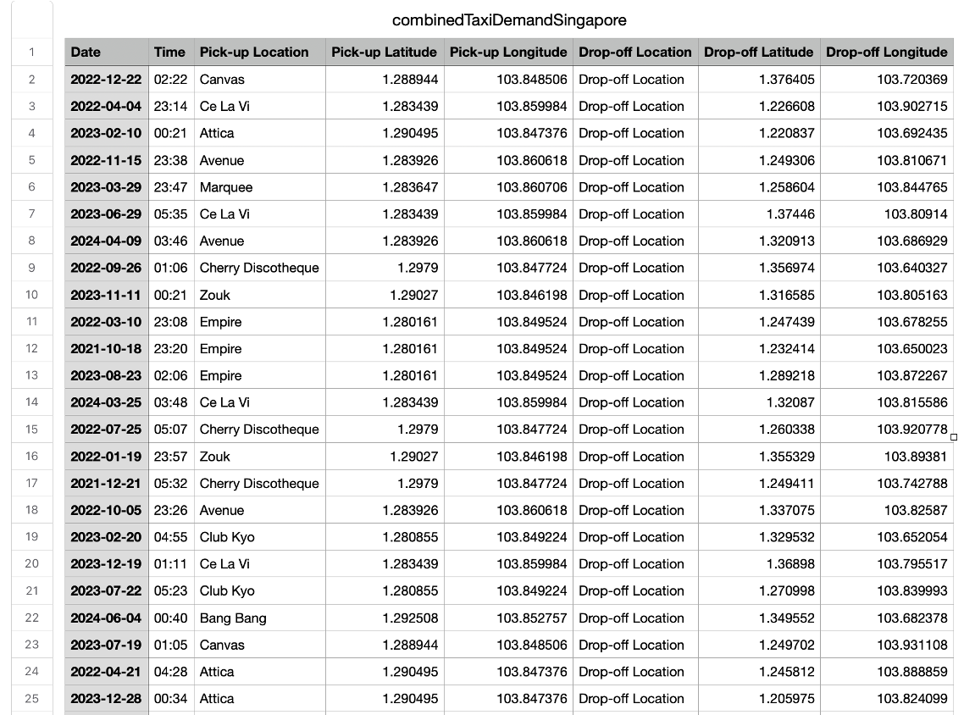
Concept Used
Briefly elaborate on what you
want to discuss.
Data Used

Slide 9
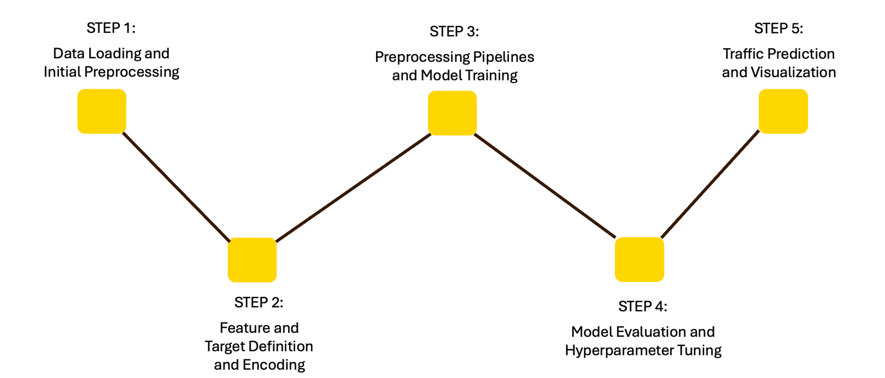
Concept Used
Briefly elaborate on what you
want to discuss.
Concept Used

Slide 10
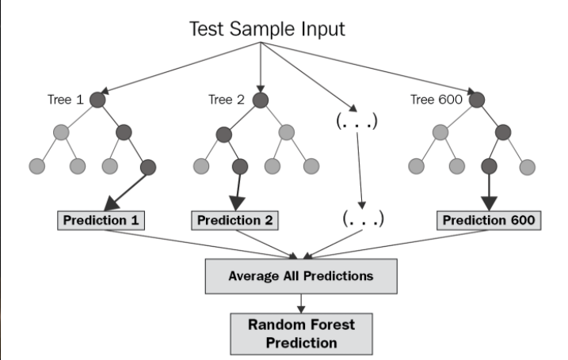
MODEL USED
Random Forest Regressor:
Ensemble learning for regression
Constructs and combines multiple decision trees
Provides robust and accurate predictions
Highlights important features

Slide 11
MODEL COMPARISON
Random Forest Regressor:
Feature Importance is more realistic.
Overfitting Reduction: Combats overfitting through random sampling.
Training Efficiency: Faster training compared to boosting methods.
Gradient Boosting:
Feature Importance is not realistic.
Overfitting: Risk of overfitting without proper regularization.
Training Efficiency: Slower training.

Slide 12
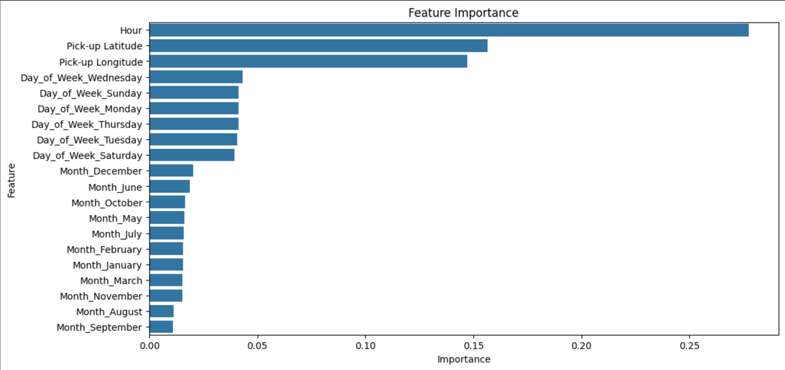
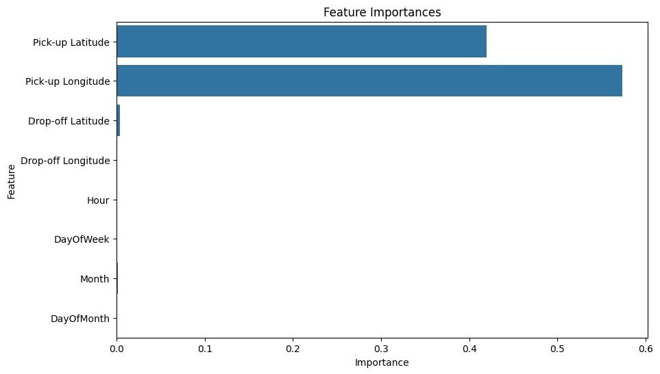
Concept Used
Feature Importance

Slide 13
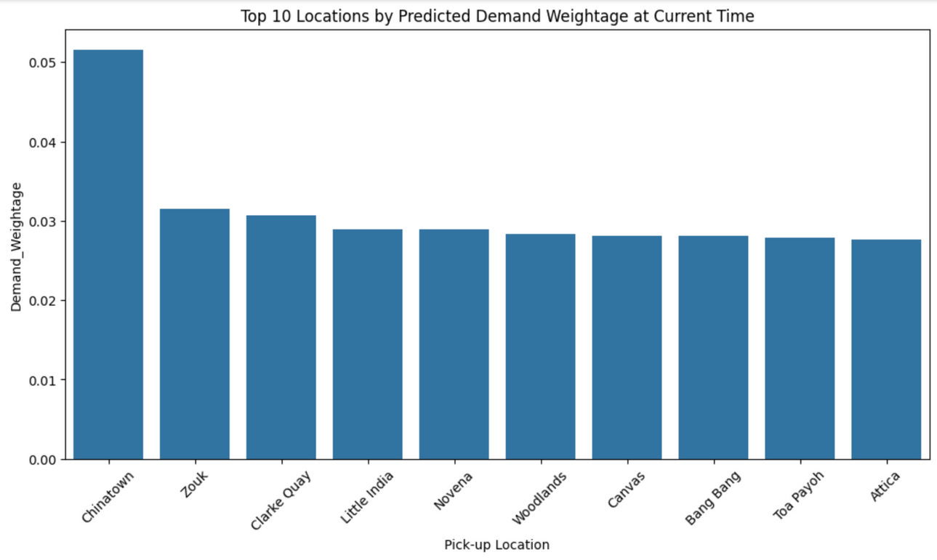
Concept Used
Briefly elaborate on what you
want to discuss.
Result

Slide 14
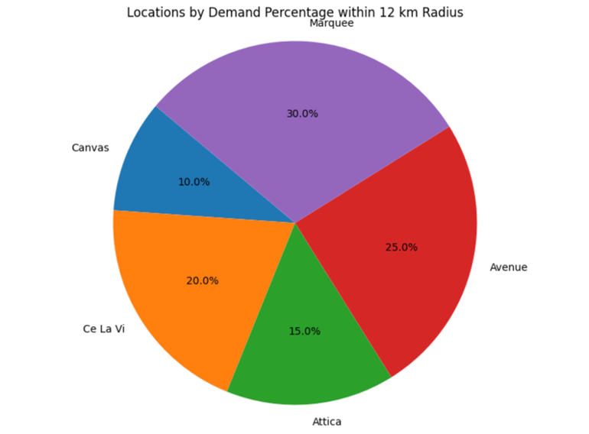
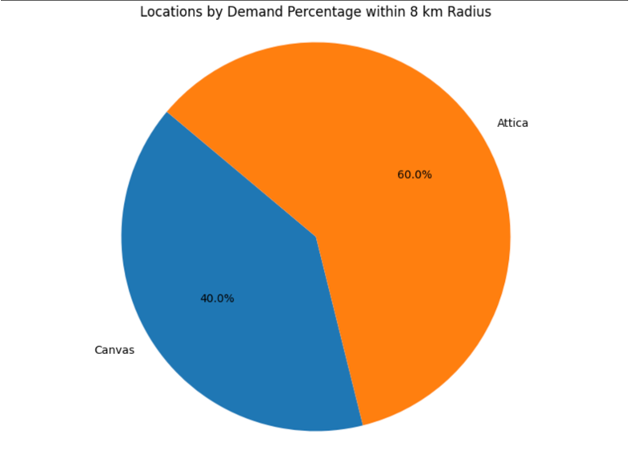

Slide 15
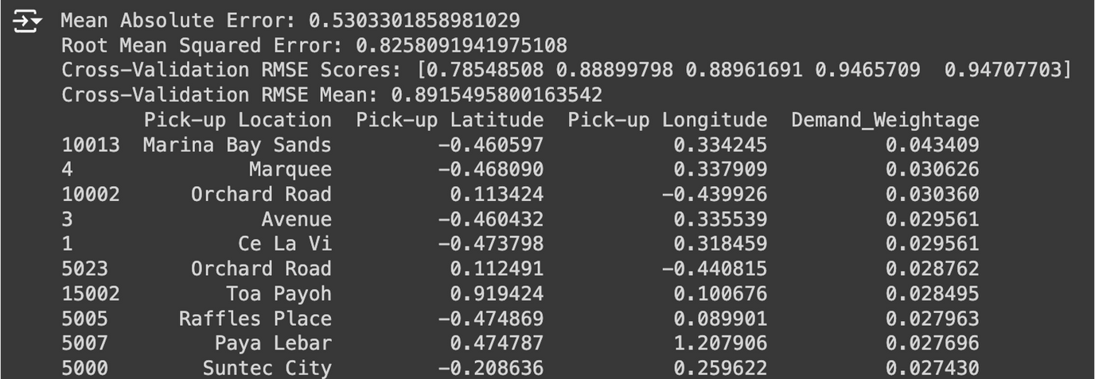
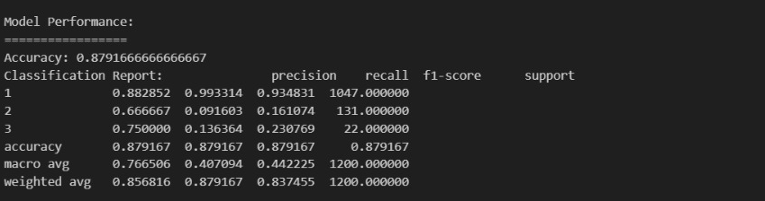
Concept Used
Briefly elaborate on what you
want to discuss.
Root Mean Square
Accuracy

Slide 16
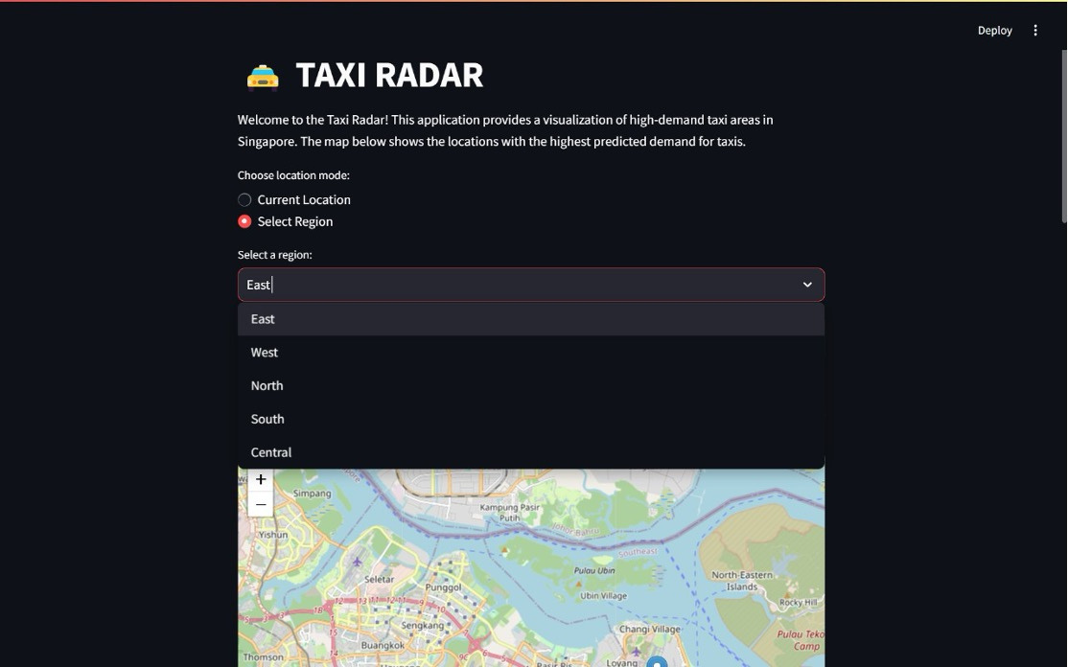
Concept Used
Briefly elaborate on what you
want to discuss.
App Demo

Slide 17
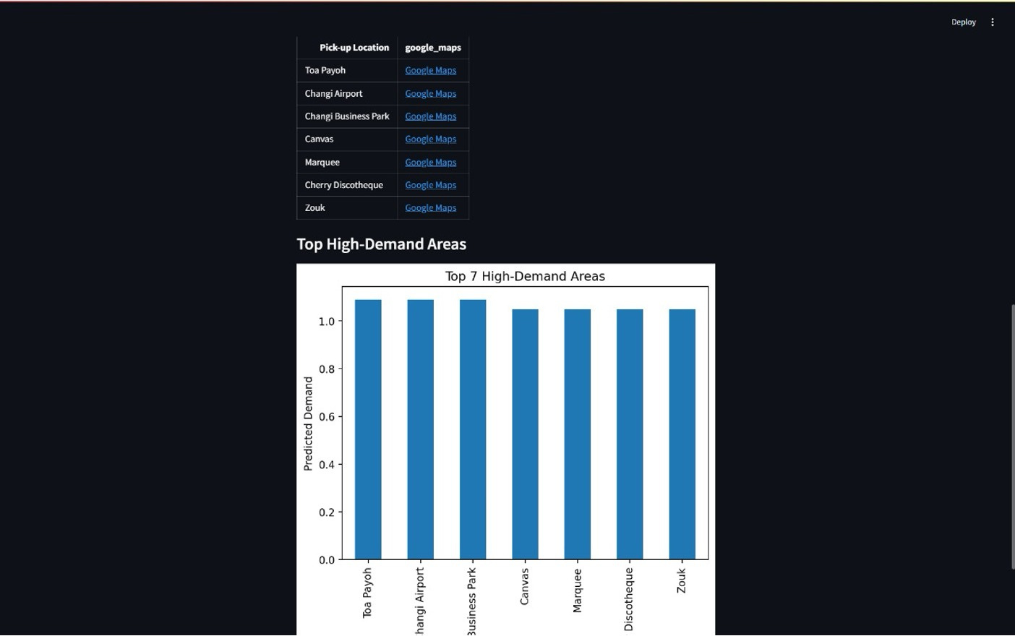

Slide 18
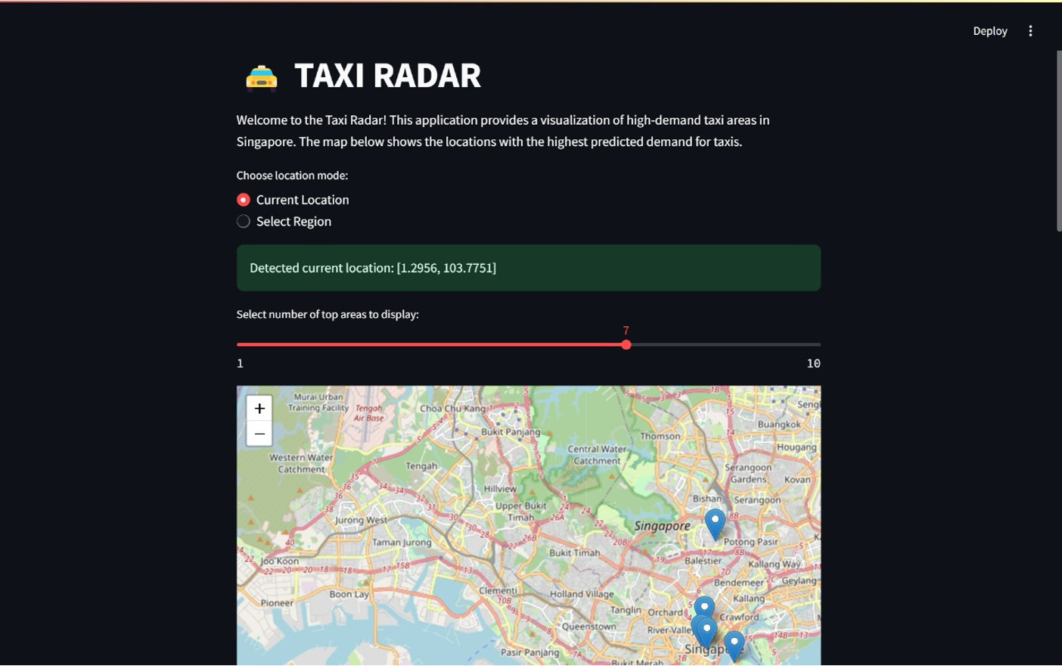

Slide 19
CHALLENGES FACED
• Data Quality
• Categorical Variables
• Feature Engineering
• Model Choice
• Evaluation
• Computational Efficiency

Slide 20
OUR LEARNING
Effective Preprocessing
Model Selection
Hyperparameter Tuning
Interpretability

Slide 21
FUTURE ENHANCEMENTS
Real-Time Prediction
Weather Data Integration
Missing Data Imputation
Deep Learning
Efficient Hyperparameter Tuning

Slide 22
CONCLUSION
Leverages Random Forest.
Identifies high-demand taxi pickups using time and location data.
Considers time intervals and days for accurate predictions.
Optimizes taxi routes dynamically.
Boosts operational efficiency and customer satisfaction.
Minimizes wait times for a seamless transportation experience.

Slide 23

THANK YOU!

